Slide 1

What does it mean to be a Data Scientist? Definitions and lessons learned from the trenches
Brian Korzynski

Slide 2


About Me
Currently
Machine Learning Architect
Previous
Sr. Machine Learning Engineer
Sr. Data Scientist
Professional Developer for 12+ years
Windows Forms
Web
Mobile
SQL Optimization
Data Analysis
Mathematics
Big Data
Cloud
Machine Learning

Slide 3
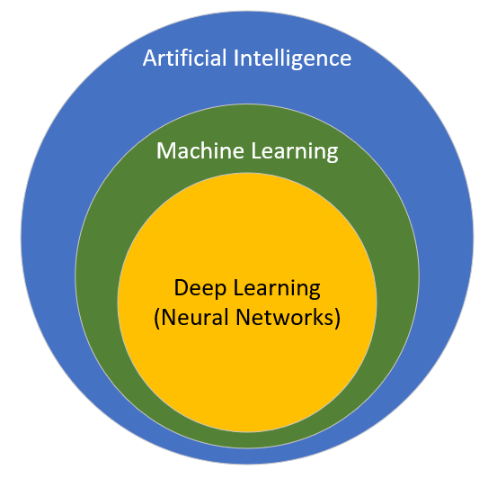
Terms
Artificial Intelligence: development of tasks that usually requiring human intelligence such as facial recognition or search
Easy for human, but hard to code
Machine Learning: use of algorithms and models to perform tasks without explicit instructions, relaying instead on patterns and inference
Rules engine where it figures out the rules for you
Deep Learning: ML methods using Artificial Neural Networks (ANN) or Neural Networks for short
Notes:
Scientific Method: https://images-na.ssl-images-amazon.com/images/I/71go0rDpVPL._SX425_.jpg

Slide 4
Types of Machine Learning Problems
Supervised
Classification (labels)
Is this email Spam or Ham?
What type of document is this?
Is this part defective (anomaly detection)
Regression (values)
Given past sales history. What should our sales be this month?
Unsupervised
Clustering – Which of these data points are most alike?
Dimensionality Reduction – What features aren’t needed?
Recommendation
You bought that, you might also like this.
Think Amazon or Netflix
Reinforcement Learning
Risk-Reward system, similar, to how humans learn
Think self-driving cars

Slide 5
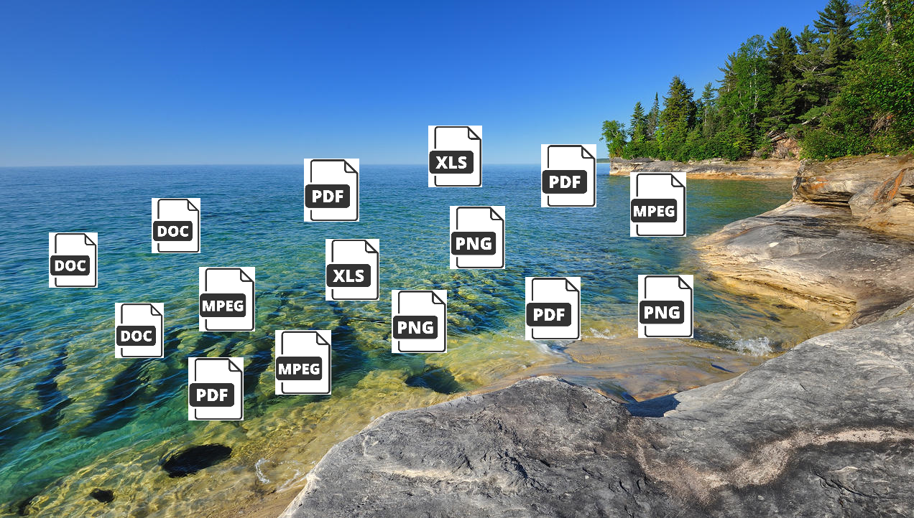
Data Lake

Slide 6
Data Lake
“A data lake is a centralized repository that allows you to store all your structured and unstructured data at any scale”
– AWS
Cloud Offerings
AWS: combination of S3 and Glacier storage (if needed)
Azure Data Lake: tool built upon Blob Storage that is compatible with the HDFS (Hadoop Distributed File System)
Google Cloud Storage
On-Premises
MINIO: alternative to AWS S3
No-SQL Offerings: MongoDB and Couchbase
Notes:
AWS Quote: https://aws.amazon.com/big-data/datalakes-and-analytics/what-is-a-data-lake/
A data lake is a centralized repository that allows you to store all your structured and unstructured data at any scale. You can store your data as-is, without having to first structure the data, and run different types of analytics—from dashboards and visualizations to big data processing, real-time analytics, and machine learning to guide better decisions.

Slide 7
Big Data
"Big data" is a field that treats ways to analyze, systematically extract information from, or otherwise deal with data sets that are too large or complex to be dealt with by traditional data-processing application software.
-Wikipedia
Notes:
https://en.wikipedia.org/wiki/Big_data

Slide 8
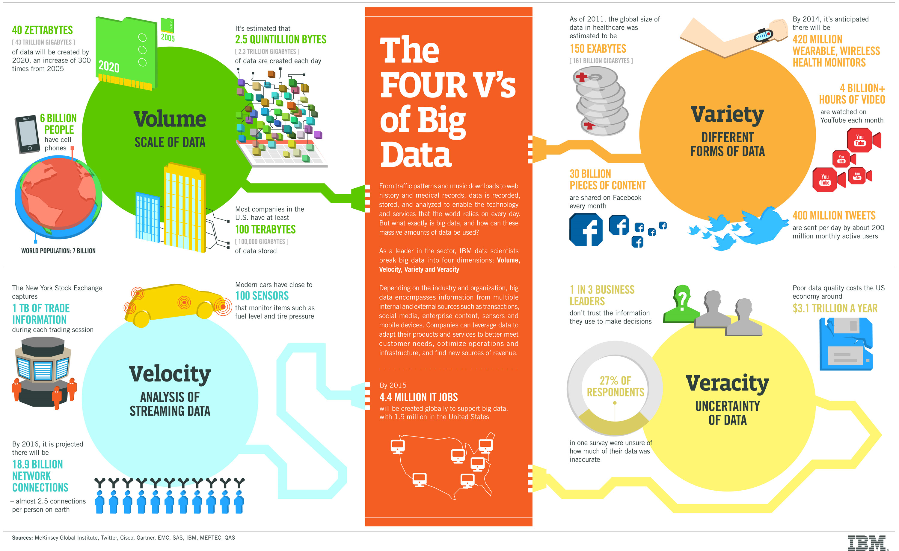
Big Data
Notes:
https://www.google.com/url?sa=i&source=images&cd=&cad=rja&uact=8&ved=2ahUKEwji8OnV65_lAhUFQ6wKHeWGA9EQjhx6BAgBEAI&url=https%3A%2F%2Fwww.ibmbigdatahub.com%2Finfographic%2Ffour-vs-big-data&psig=AOvVaw2wEptWXfw2bdWhOin0tC2j&ust=1571283055261924
Doesn’t necessarily have to be Hadoop

Slide 9
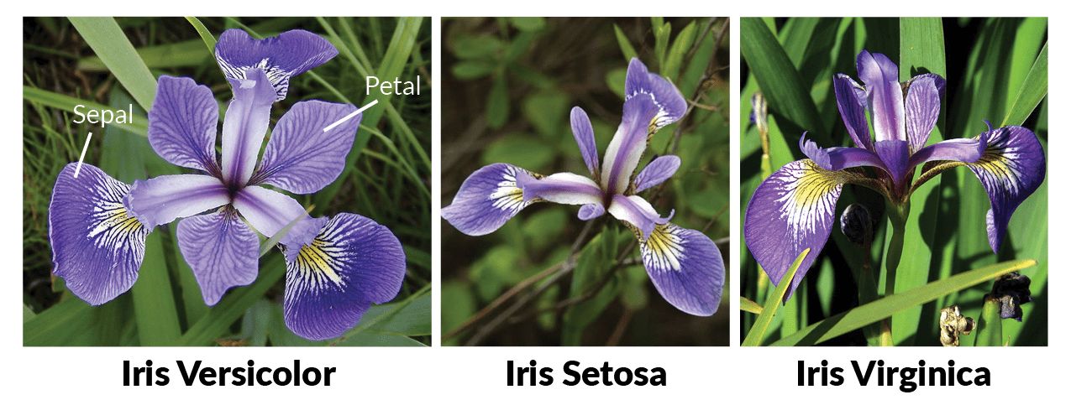
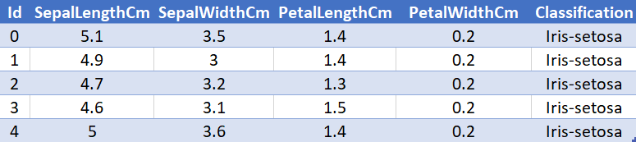
Preparing Data: The Iris Dataset
Notes:
https://www.kaggle.com/akashsri99/deep-learning-iris-dataset-keras

Slide 10
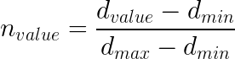
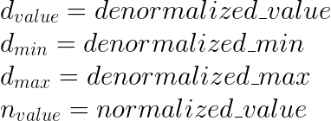
Normalize Input (Range Normalize)
Sepal Length
Min: 4.300
Max: 7.900
Sepal Width
Min: 2.0
Max: 4.4
Petal Length
Min: 1
Max: 6.9
Petal Width
Min: 0.1
Max: 2.5
Notes:
Measurements: http://rstudio-pubs-static.s3.amazonaws.com/324830_8985f6dac8d34633b6cf23a92ff3e64c.html

Slide 11
Normalize Output
Possible Output Labels
Setosa
Virginica
Versicolor
Each record can be one and only one of these.
One-Hot Encoding:
Have each of the possible labels in the output layer and put a 1 in the corresponding position of the label and 0 for every other label

Slide 12
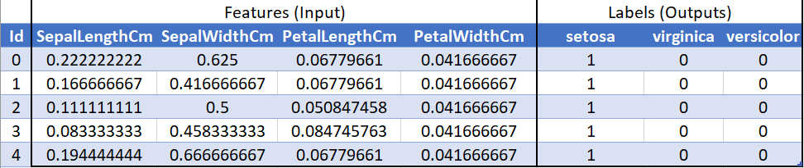
Before and After Normalization

Slide 13
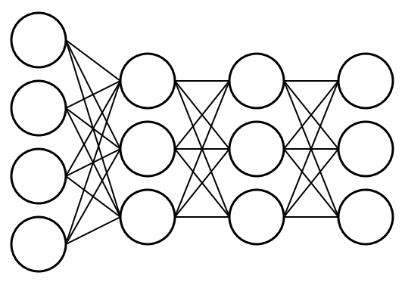
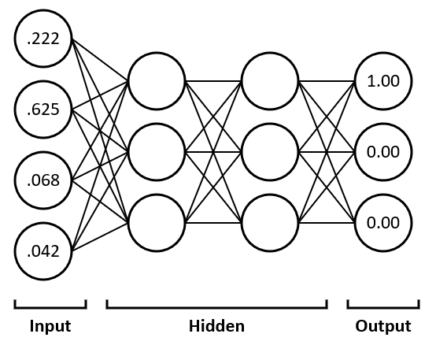
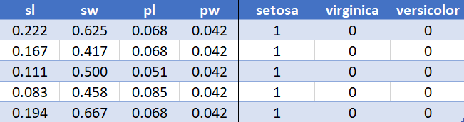
Building the Network

Slide 14

What is data science?
Everyone has their own definition since there isn’t an official one.
“Data science is a multi-disciplinary field that uses scientific methods, processes, algorithms and systems to extract knowledge and insights from structured and unstructured data.” – Wikipedia
Notes:
https://towardsdatascience.com/introduction-to-statistics-e9d72d818745
Gross over simplification

Slide 15
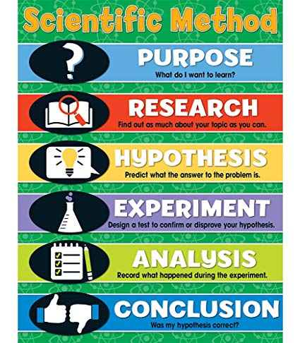

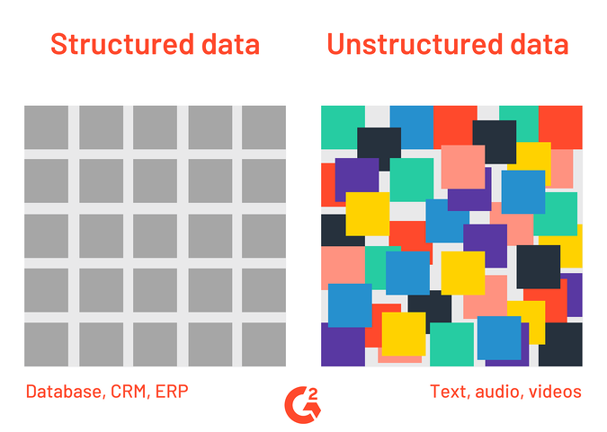
“Data science is a
multi-disciplinary
field that uses
scientific methods,
processes, algorithms and systems
to
extract knowledge and insights
from
structured and unstructured
data.”
– Wikipedia
Math
Programming
Machine Learning
Notes:
Scientific Method: https://images-na.ssl-images-amazon.com/images/I/71go0rDpVPL._SX425_.jpg
Extracted data: https://docparser.com/blog/extract-data-from-pdf/
(edited by me)
Structured vs. Unstructured Data: https://learn.g2.com/structured-vs-unstructured-data

Slide 16
What is data science?
“Data science is a multi-disciplinary field that uses scientific methods, processes, algorithms and systems to extract knowledge and insights from structured and unstructured data.” – Wikipedia
“Machine Learning is a multi-disciplinary field that uses scientific methods, processes, algorithms and systems to extract knowledge and insights from structured and unstructured data.” – Wikipedia
Notes:
https://towardsdatascience.com/introduction-to-statistics-e9d72d818745

Slide 17
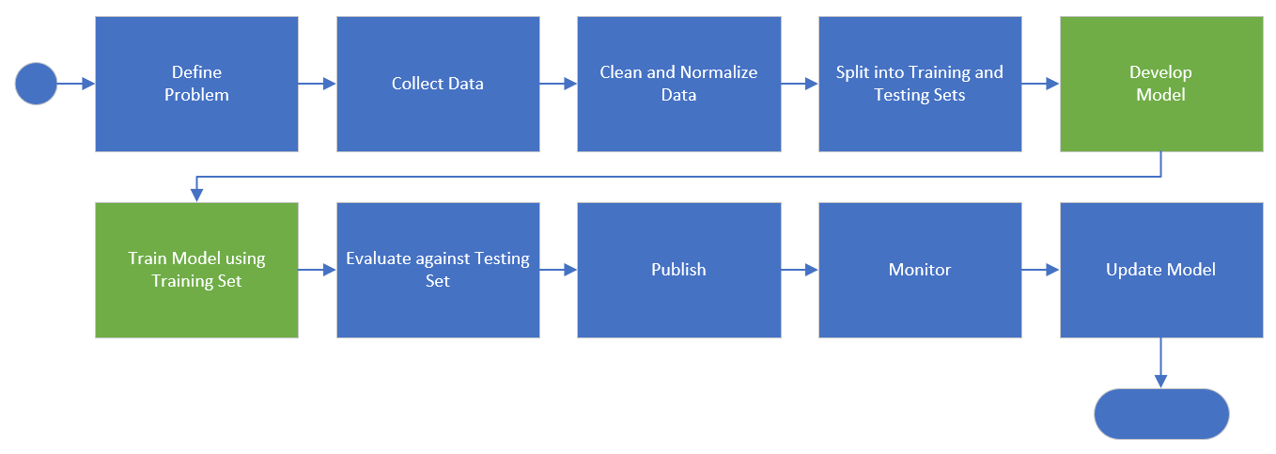
ML Process
Notes:
Mention programming problems vs. ML problems
Mention their could be other steps depending on the responsibilities listed before

Slide 18
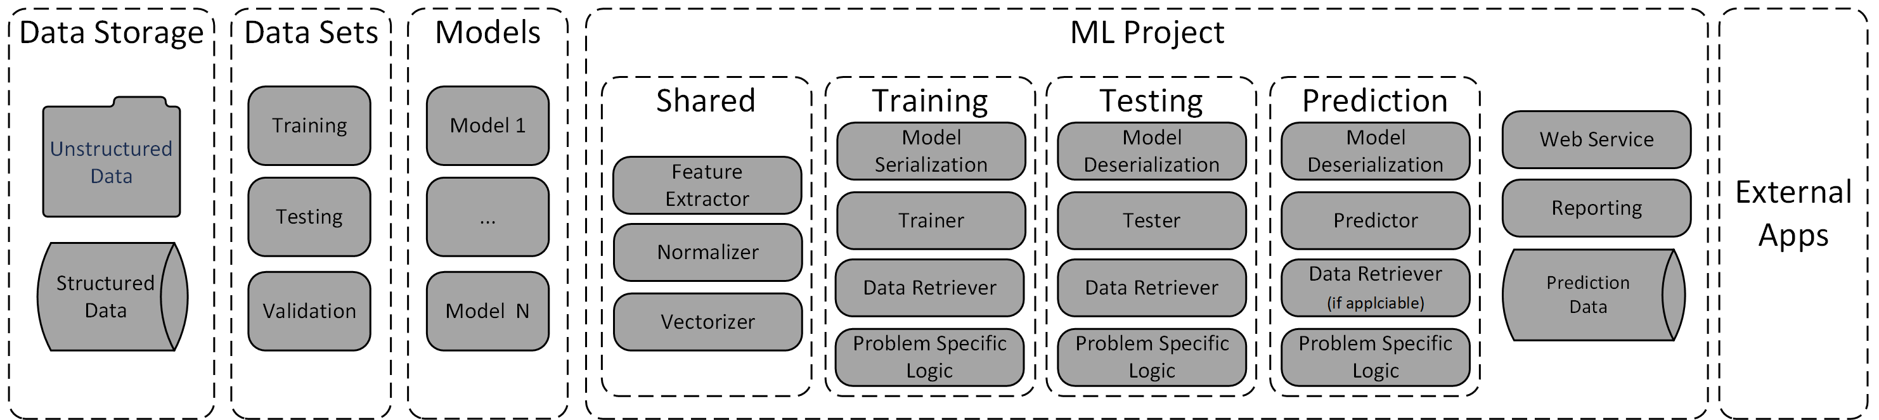
ML Project Composition

Slide 19
Roles in Data Science and ML Teams
What is the difference between a Programmer, a Software Engineer, and an Architect?
It depends on the company in question and their views.

Slide 20
Programmer vs. Software Engineer vs. Architect
Programmer is someone who writes code
Software Engineer applies engineering principles to the design, development, maintenance, testing and evaluation of their software.
Software Architect is someone who deals with the high-level design of how systems connect together, chooses the best technologies, and the handles mapping between business requirements and engineering requirements.
Companies tend to use these terms interchanageably to denote a person’s rank or skill level. Especially, if there is a lot of overlap in responsibilities.

Slide 21
Programmer vs. Computer Scientist
Programmer
Writes code to solve business problems
Computer Scientist
Develops new products to solve computing problems, choosing the correct technology for the problem.
Focus: Applicable
Focus: Research

Slide 22
ML Engineer vs. Data Scientist
ML Engineer
Writes code to solve business problems using machine learning
Data Scientist
Develops new products to solve ML problems, choosing the correct technology for the problem, dealing with compliance, and other high level tasks.
Focus: Applicable
Focus: Research

Slide 23
Roles in Data Science and ML Teams
Programmers: integrate ML applications and services into other applications
DevOps: deals with the deployment, monitoring, and infrastructure for the application
Data Engineer: focuses on gather, organizing, and preparing data for use by machine learning applications. This includes munging and labeling.
Data Architect: establishes data security, storage, and access standards.
ML Engineer: programmer that works closely with the other roles to create ML models and applications using data. Their focus is on ML problems not traditional programming problems like that of the programmer.

Slide 24
Roles in Data Science and ML Teams
Data Scientist: performs similar functions to that of a ML engineer, however, just like the Computer Scientist their focus is on research, and more high-level or generic tasks.
In short, the ML Engineer focuses on creating working applications using ML, whereas a Data Scientist focuses more on the research and high-level tasks such as creating tools, ensuring compliance, and reporting on performance.

Slide 25
Responsibilities
Looking for business opportunities – Data Scientist
Defining the problem – Data Scientist
Define metrics for success – Data Scientist
Establish data security, storage, and access standards – Data Architect
Choose algorithms – Data Scientist
Decide how much data is needed – Data Engineer & ML Engineer
Discover how much variability in the data – Data Engineer & Data Scientist
Collect data – Data Engineer
Label the data – Data Engineer
Cleanse data – Data Engineer
Normalize data – Data Engineer
Split into testing and training sets – Data Engineer
Human Bias Analysis (if applicable) – Data Engineer
Create models – ML Engineer
Validate Models – ML Engineer
Deployment – DevOps
Monitoring – DevOps
Reporting – Data Scientist

Slide 26
Other Data Scientist Responsibilities
Ensure compliance standards such as the EU General Data Protection Regulation (GDPR)
Establish normalization strategies
Choosing the standards Platforms and tooling
Tool creation (along with the ML Engineer)
Help Diagnose issues with models
Generic Model creation for Transfer Learning

Slide 27
Roles and Responsibilities
These roles are assuming that you are either an AI-centric organization or have a large amount of AI work to have these certain roles.
For my work as a ML Engineer, myself and a co-worker or the only ones that do ML work, so we end up splitting the tasks of all of those roles between us.
For my work as a Data Scientist, we have several ML Engineers that handle the work of the programmer, ML Engineer, and Data Engineer. Everything is handled by me.

Slide 28
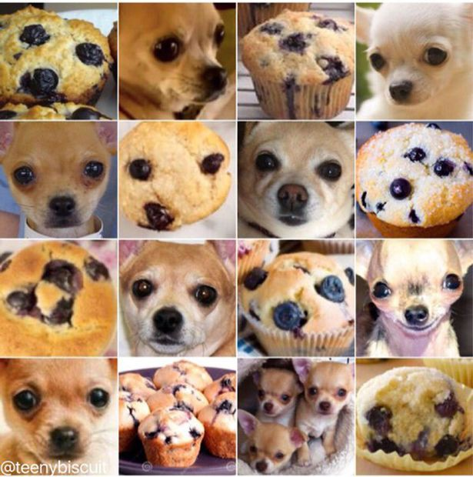
Responsibility Example: Image Classification
Determine if given image is a Blueberry Muffin or a Chihuahua
The Data Engineer gathered and labeled the data for model creation.
Notes:
https://miro.medium.com/max/615/1*DGDcAQmm0e0kW_1iON1e-Q.jpeg

Slide 29
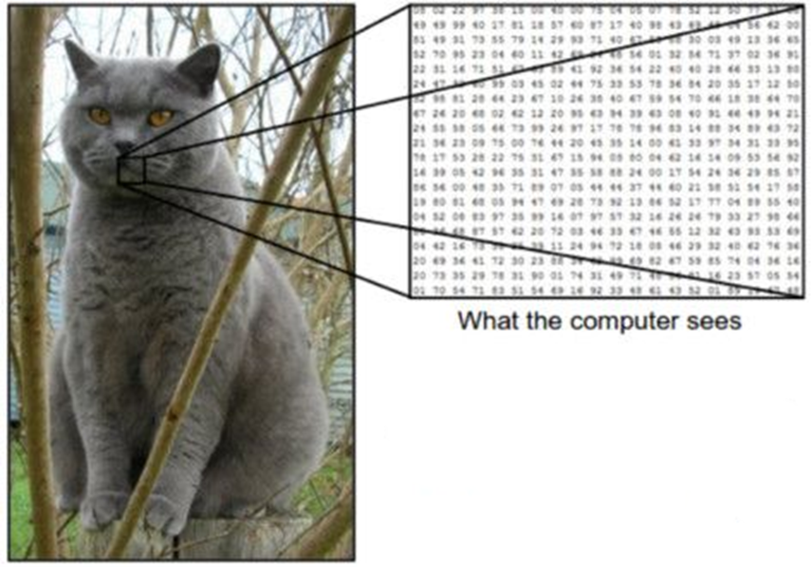
Preparing Data (Mathify) – The Data Scientist
ML algorithms only work with numbers therefore you have to convert your data into numbers before you can train models and make predictions.
Notes:
https://www.kdnuggets.com/2017/08/convolutional-neural-networks-image-recognition.html?utm_content=buffer640a1&utm_medium=social&utm_source=pinterest.com&utm_campaign=buffer

Slide 30
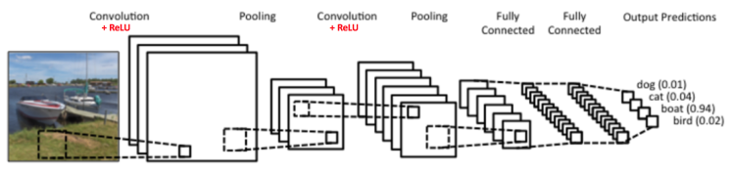
The Data Scientist
Notes:
https://ujjwalkarn.me/2016/08/11/intuitive-explanation-convnets/
GoogleNet: https://i.stack.imgur.com/Xqv0n.png

Slide 31

The Data Scientist
Notes:
https://i.stack.imgur.com/Xqv0n.png

Slide 32
The ML Engineer
from googlenet import create_googlenet
model = create_googlenet()
sgd = SGD(lr=0.1, decay=1e-6, momentum=0.9, nesterov=True)
model.compile(optimizer=sgd, loss='categorical_crossentropy’)
model.fit(x,y, verbose=1, batch_size=1, epochs=1000)

Slide 33

The ML Engineer
Notes:
https://pbs.twimg.com/media/CdIm-TwUMAI-HLt.jpg

Slide 34
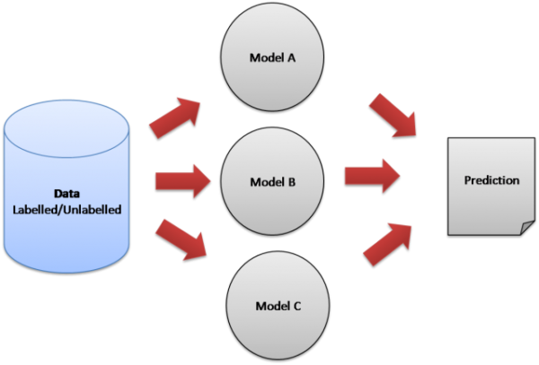
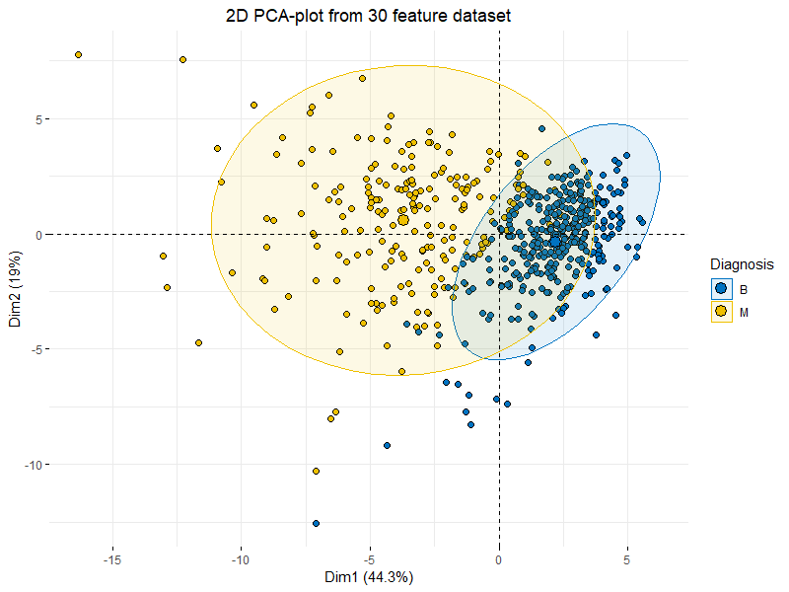
Combating Massive Amount of Variation in your data
Unsupervised Learning
Clustering
Dimensionality Reduction
Principle Component Analysis (PCA)
Ensemble Learning

Slide 35
Realities
Most ML/DS projects don’t exist on their own, they are usually integrated into other systems
Most real-world ML projects will implore more than one ML component
If there is bias in your data, then the ML app will pick up over apply it everywhere
Thou must know thy data

Slide 36
Realities
There is the what we care about and what the client cares about.
We care about things like recognition rate, precision, recall, etc.
Clients care about things such as minimizing false positive rates

Slide 37


Thanks to our sponsors

Slide 38
Questions
github.com/korz
@bkorzynski

